Slide 1
Salary prediction of data professions
A Comprehensive Analysis and Modeling Approach

Slide 2
CONTENTS
Introduction
Data Overview
Exploratory Data Analysis
Key Insights from EDA
Feature Engineering
Data Preprocessing
Model Training and Evaluation
Model Deployment

Slide 3
INTRODUCTION
Salary prediction is crucial for understanding compensation trends and making informed career and business decisions in the data industry.​
The goal is to identify key factors influencing salaries and to develop a reliable predictive model.​

Slide 4
Data Overview
The dataset is sourced from "Salary Prediction of Data Professions."​
It includes comprehensive information on various aspects of data professionals, making it a rich source for predictive analysis.
Key Features:
FIRST NAME, LAST NAME: Identifiers
SEX: Gender of the professional
DOJ (Date of Joining): Start date of employment
CURRENT DATE: Date of data snapshot
DESIGNATION: Job title or role
AGE: Age of the professional
SALARY: Target variable, annual salary in dollars
UNIT: Department or business unit
LEAVES USED: Number of leaves taken
LEAVES REMAINING: Remaining leave balance
RATINGS: Performance ratings
PAST EXP: Years of previous work experience

Slide 5
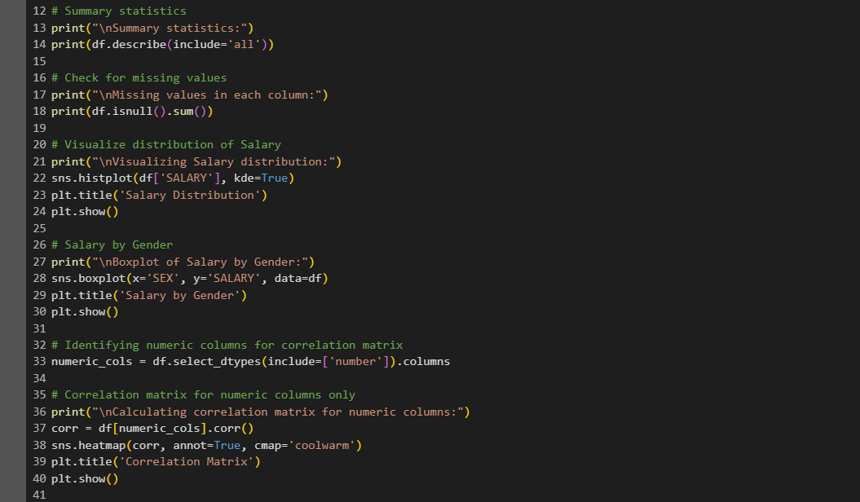
Exploratory Data Analysis (EDA)
Uncovering underlying patterns and insights in the dataset.
Techniques Used:
Summary Statistics: Gained an overall understanding of data distributions.
Data Visualization: Used histograms, box plots, and scatter plots.
Correlation Analysis: Identified relationships between features.

Slide 6
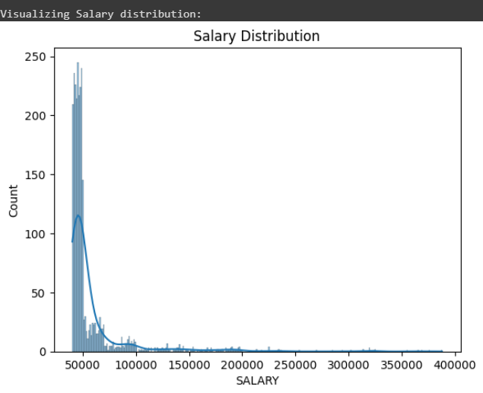
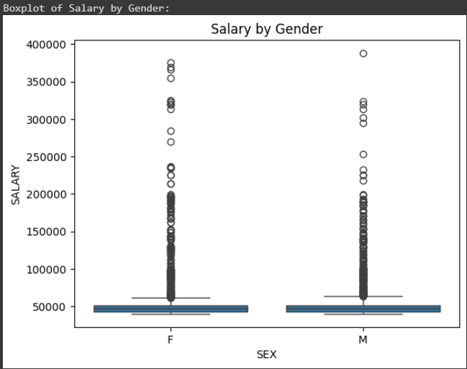
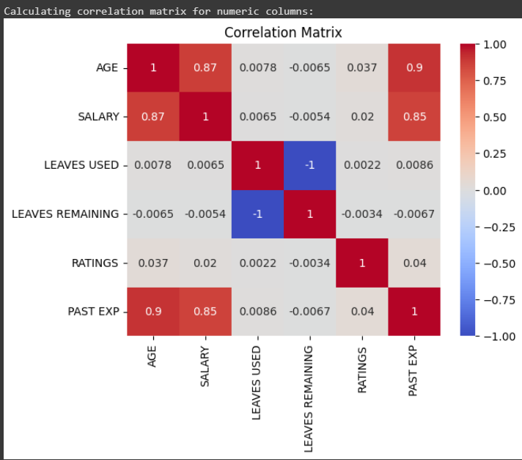
Key Insights from EDA
Age and Salary:
Observed a positive correlation indicating that salary tends to increase with age.
Experience and Salary:
Higher past experience correlates with higher salaries.
Designation Impact:
Certain job roles have significantly higher salaries compared to others.

Slide 7
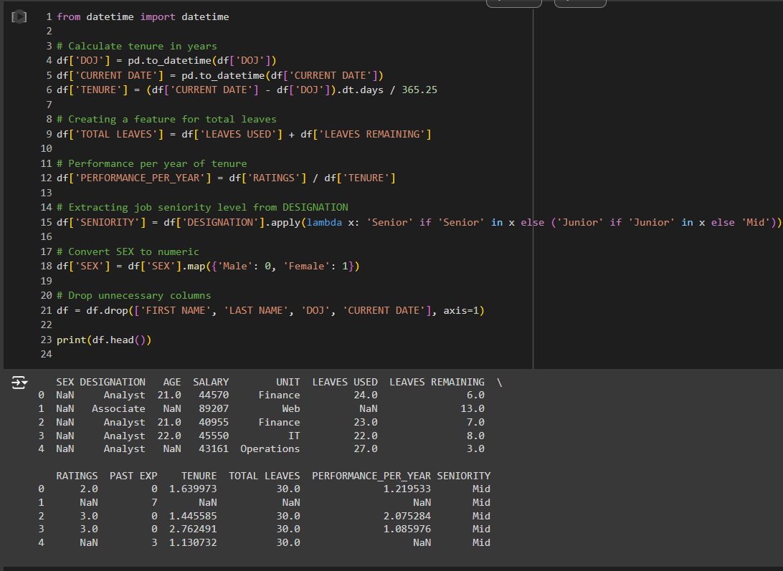
Feature Engineering
New Features Created:
TENURE: Derived from DOJ and CURRENT DATE.
TOTAL LEAVES: Sum of LEAVES USED and LEAVES REMAINING.
PERFORMANCE_PER_YEAR: Calculated as RATINGS divided by TENURE.
SENIORITY: Categorized from DESIGNATION.

Slide 8
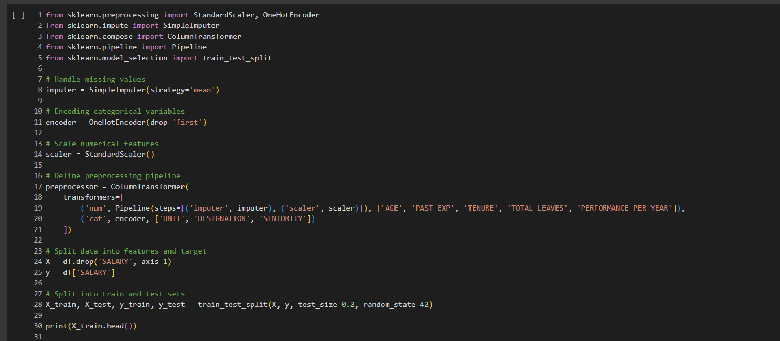
Data Preprocessing
Steps Involved:
Missing Values: Handled with mean imputation for continuous features.
Categorical Encoding: Used One-Hot Encoding for categorical features like UNIT, DESIGNATION, and SENIORITY.
Feature Scaling: Applied StandardScaler to numerical features to standardize data.

Slide 9
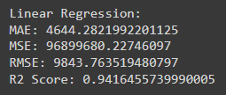
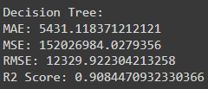
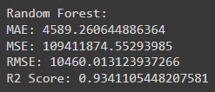

Model Training & evaluation
Models Evaluated:
Linear Regression: Simple and interpretable.
Decision Tree: Captures non-linear relationships.
Random Forest: Ensemble method for better accuracy.
Gradient Boosting: Boosting technique for reducing bias and variance.
Selection Criteria:
Based on evaluation metrics such as MAE, MSE, RMSE, and R².
Linear Regression
Decision Tree
Random Forest
Gradient Boosting
"The best model comes out to be Linear Regression"

Slide 10
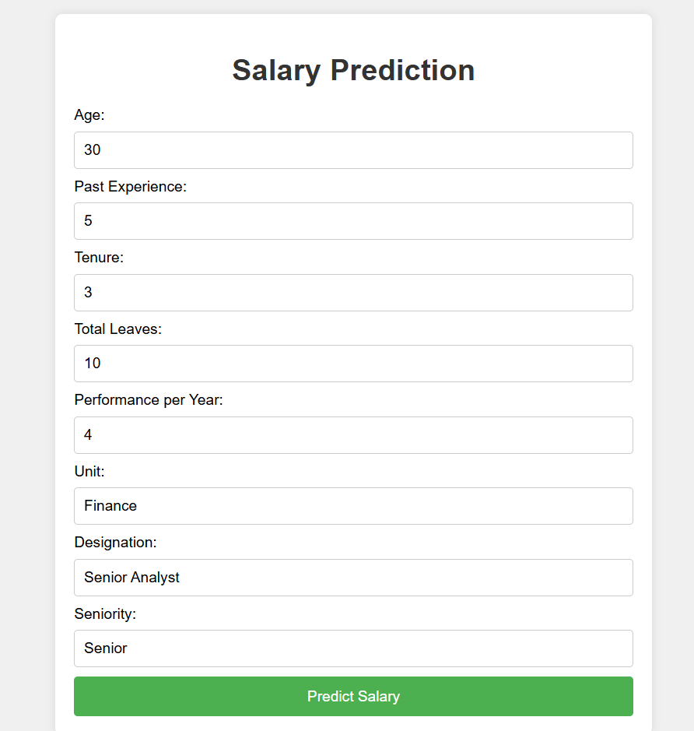
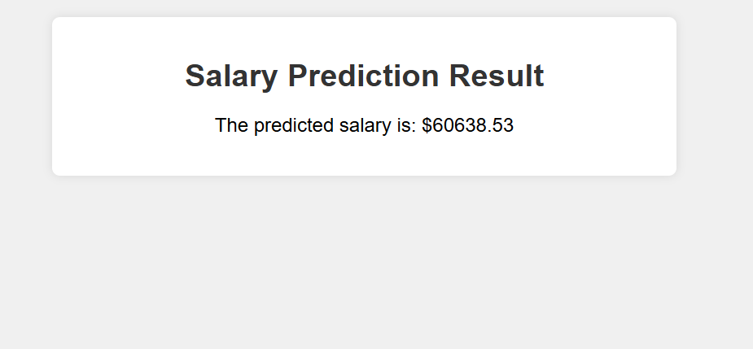
Model Deployment
Deployment Steps:
Flask Application: Developed a web app using Flask for user interaction.
Model Saving: Saved the trained model using Joblib.
Form Setup: Created a user-friendly input form for salary prediction.

Slide 11
THANK YOU

